Slide 1

Data Analytics & Business Solutions
Ryan McDonald - Justin Drouin – Alexander Frederick

Slide 2

Purpose
DABS is a small business solution for inventory management, sales, transactions analytics, custom invoicing software. Our mission is to provide a database of information about your product sales, customers, and inventory into an easy to read format that fits the needs of the business owner. We offer the ability to display and update information that fits certain criteria, specific to the needs of the user

Slide 3
Product Scope
This software is intended to make it easier and less expensive for small businesses to generate sale reports and invoices, maintain customer information and transactions in a database, and apply analytics across all data sets.
The core of the application is written in C++ in the Qt IDE for UI creation.
The database to manage and maintain all data sets is an AZURE SQL Database.

Slide 4
USE CASE

Slide 5
SEQUENCE DIAGRAM

Slide 6
SWIMLANE

Slide 7
UML CLASS DIAGRAM

Slide 8
UML STATE DIAGRAM

Slide 9
CRC

Slide 10
ACTIVITY DIAGRAM

Slide 11
Test Case | Pass/fail
Customer can’t SQL inject | pass
login -> valid or invalid. | pass
Customer order -> can place empty order(cant) -> can add 0 to cart(cant) | pass
Employee can view inventory | pass
Employee can view sales | pass
Employee can filter inventory | pass
Customer can place an order | pass
Customer can view previous orders | pass

Slide 12
On launching the application, a connection is made to the database where a user is prompted to log in with their given credentials. Upon a successful log in attempt, the user is given an appropriate GUI for their access level. This access level is tied to the users account in the database. Employees are able to have access to all elements in the database as well as being able to generate reports.
Login

Slide 13
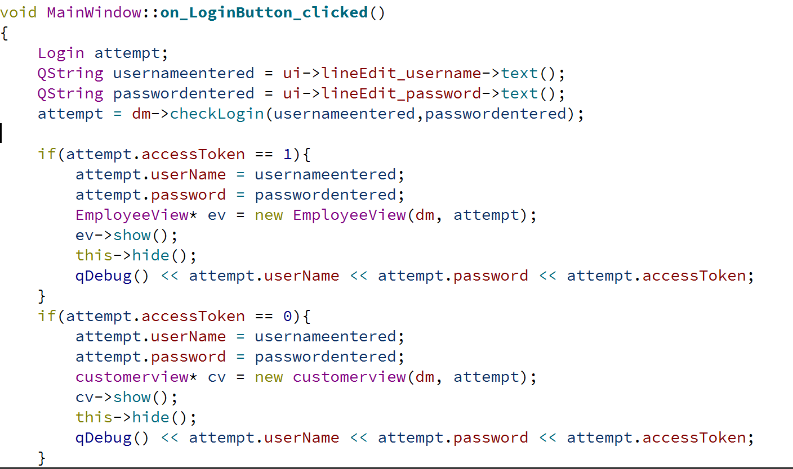
Login Code for Employee vs Customer

Slide 14
Sales

Slide 15
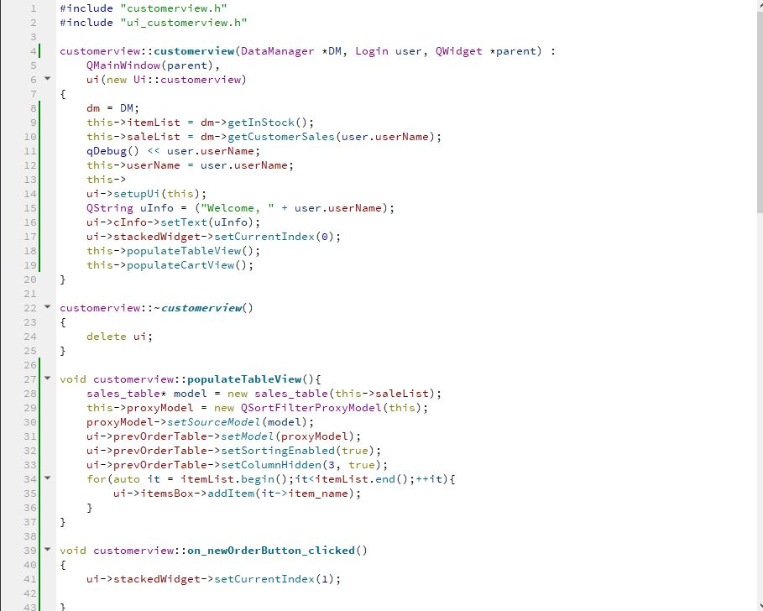
Customer View Code

Slide 16
Orders

Slide 17
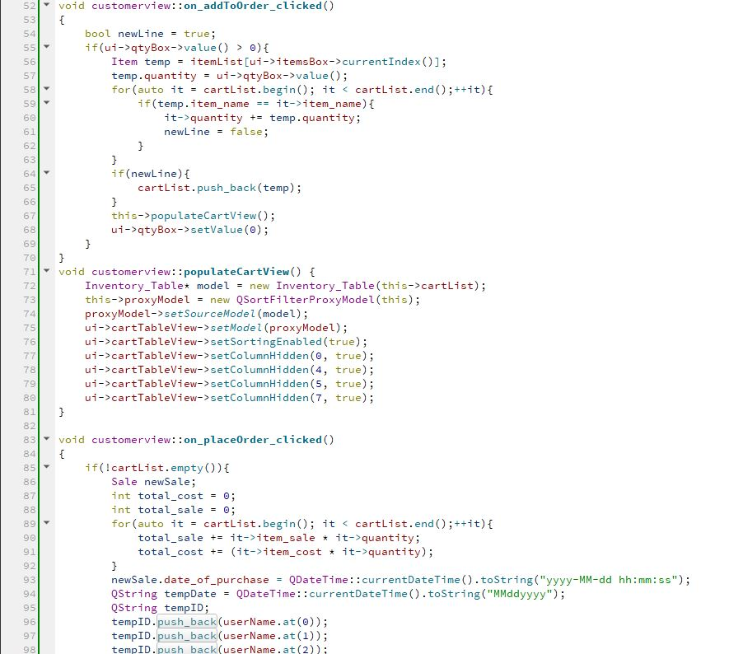
Order / Cart Code

Slide 18
Inventory & reports

Slide 19
Sales reports

Slide 20
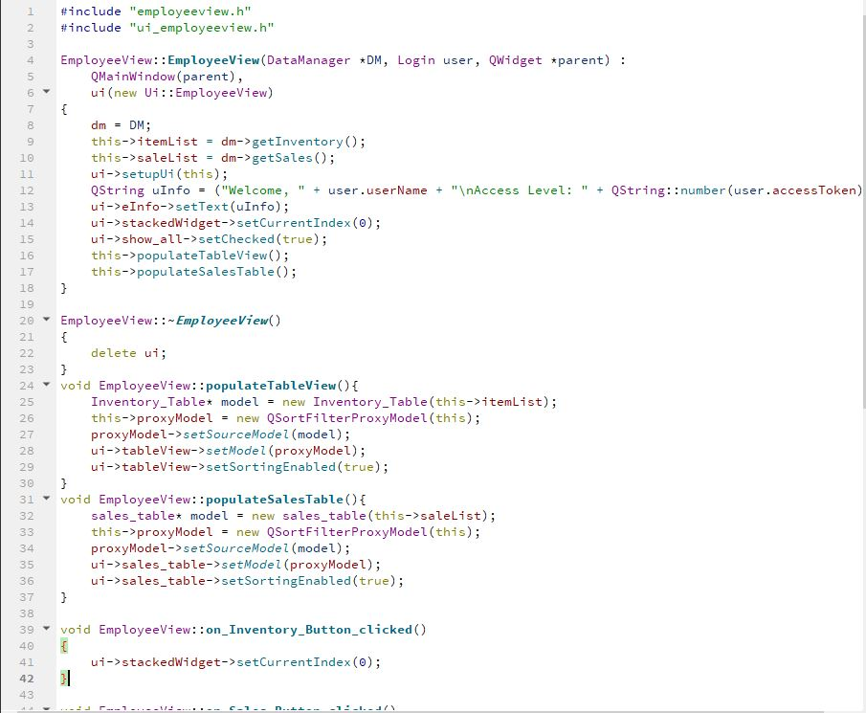
Employee View Tables Code

Slide 21
Github / credits
Ryan McDonald | Justin Drouin | Alexander Frederick
Database (AZURE SQL) | Diagrams | QT IDE Dev C++
 | UI (CSS)
Github
https://github.com/flocka89/DABS_CPSC362

